Slide 1




Unified CPU and GPU sampling with the
TAU Performance System®
17th International Parallel Tools Workshop
Jordi Alcaraz
Research Associate
Performance Research Laboratory, OACISS, University of Oregon
jordia@uoregon.edu

Slide 2
Motivation
Instrumenting entry and exit points provides a general idea of the time spent in an application
As functions become larger and more complex, entry and exit points provide little information
Finer-grained analysis is necessary to identify performance bottlenecks
Profiling every line or instruction of an application is not feasible
  Increases profiling overhead
  Generates large amounts of profiling data

Slide 3
Our approach
Periodically sample the application to identify performance hotspots
  Low overhead
  No need to modify the application or executable
CPU uses signals to interrupt execution and collect samples
GPUs provide samples using their own APIs
Integrate CPU and GPU sampling into the TAU Performance System

Slide 4
TAU Performance System®
Tuning and Analysis Utilities
Supports profiling and tracing for a variety of runtimes:
  MPI, CUDA, ROCm, Intel Level Zero, OpenCL, OpenMP, and others.
Portable across architectures: x86, ARM, CRAY, PowerPC, etc.
Supports hardware performance counters with PAPI, Likwid and GPU APIs
Profiles uninstrumented binaries with tau_exec or tau_python
Can instrument applications using compiler instrumentation, PDT, DyninstAPI and MAQAO
Tracing is also available with Jumpshot, Vampir and Perfetto

Slide 5
TAU Performance System®
Open Source
Configure for the required hardware and runtimes:
  ./configure -cuda=$CUDA_PATH -ompt -perfetto -otf=download
  ./configure -rocm=$ROCM_PATH -rocprofsdk -ompt -perfetto -otf=download
  ./configure -level_zero=$L0_PATH -ompt -perfetto -otf=download
IMPORTANT: with -ompt, compile with the same compiler as your application
Enable APIs when executing TAU for your application:
  tau_exec -cuda <application>
  tau_exec -l0 <application>
  tau_exec -rocm <application>
Enable tracing and select the format:
  TAU_TRACE=1
  TAU_TRACE_FORMAT=perfetto

Slide 6
CPU event based sampling
Architecture independent (ARM, x86_64, PowerPC,...)
No external API dependencies*
Stops application at set intervals
  Time based sampling uses POSIX timers to call a signal
  * PAPI counters use overflow handler
Reads the program counter and associates the sampling interval to the sample

Slide 7
CPU event based sampling
Environmental variables
TAU_EBS_UNWIND //Unwind the callstack
TAU_EBS_RESOLUTION=line //Can be set to function or file
TAU_EBS_SOURCE=itimer //In μs, accepts metrics (PAPI_TOT_INS)
TAU_EBS_PERIOD=<value> //Sample each X units
How to use
tau_exec -ebs <application>

Slide 8
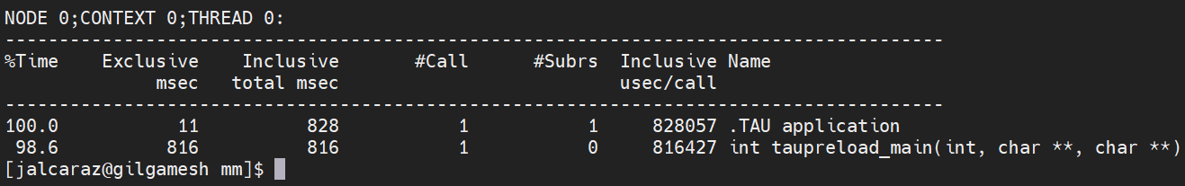
CPU uninstrumented profiling
Exclusive : time spent in a function, excluding its calls
Inclusive : time spent by the function and its calls
.TAU application: top-level timer. Includes application initialization.

Slide 9
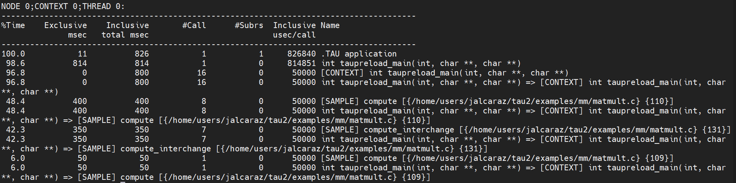
CPU event based sampling
1 sample every 50 miliseconds

Slide 10
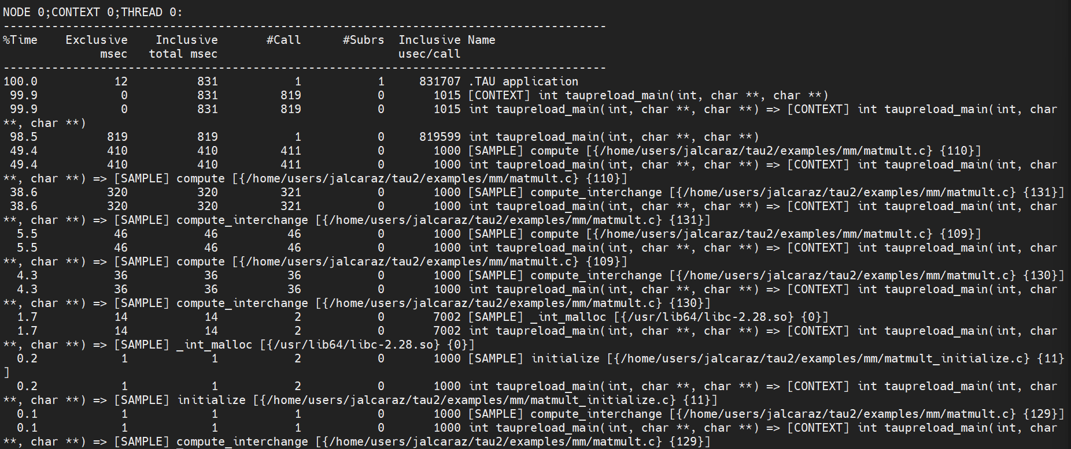
CPU event based sampling
1 sample every millisecond, overhead lower than 1%

Slide 11
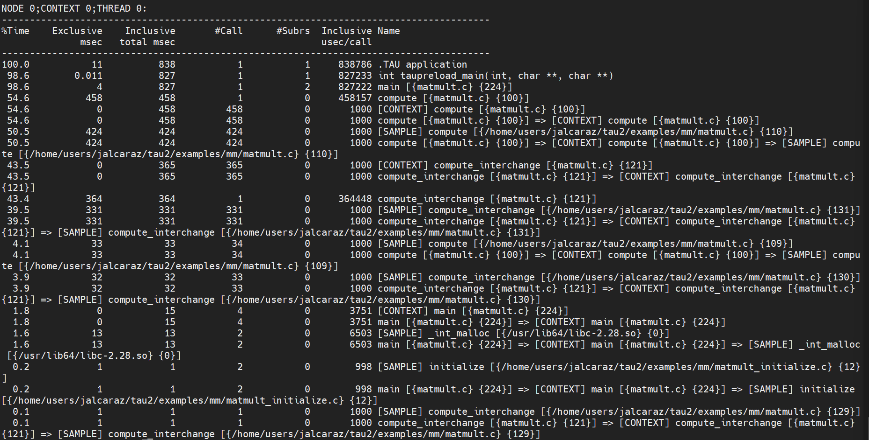
CPU sampling and compiler instrumentation

Slide 12
GPU sampling
Adds significant overhead as APIs serialize kernels
May not work with all GPUs
Vendor specific limitations and requirements

Slide 13
CUDA sampling
Provides stall reason
Does not provide timestamps
Requires reserving GPU memory
  May need multiple GBs, more memory=more overhead
  May crash without enough memory (TAU_CUPTI_PC_HWB in MB)
Can set sampling interval with TAU_CUPTI_PC_PERIOD
Interval in cycles
tau_exec –cupti_pc <application>

Slide 14
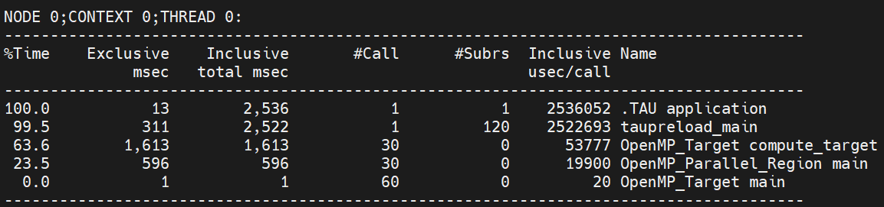
CUDA sampling
Without sampling nor CUPTI

Slide 15
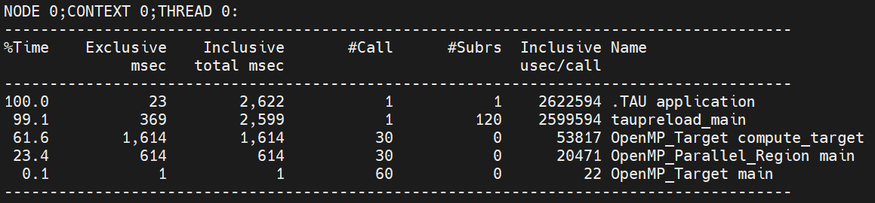
CUDA sampling
Without sampling nor CUPTI
With CUPTI

Slide 16
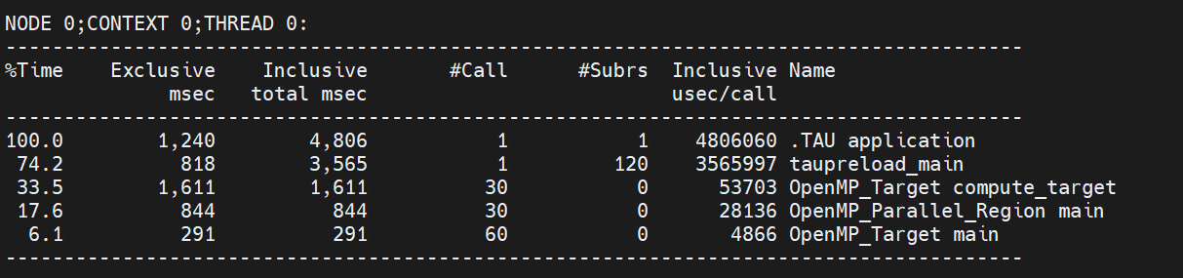
CUDA sampling
With CUPTI
With sampling, overhead 100%

Slide 17
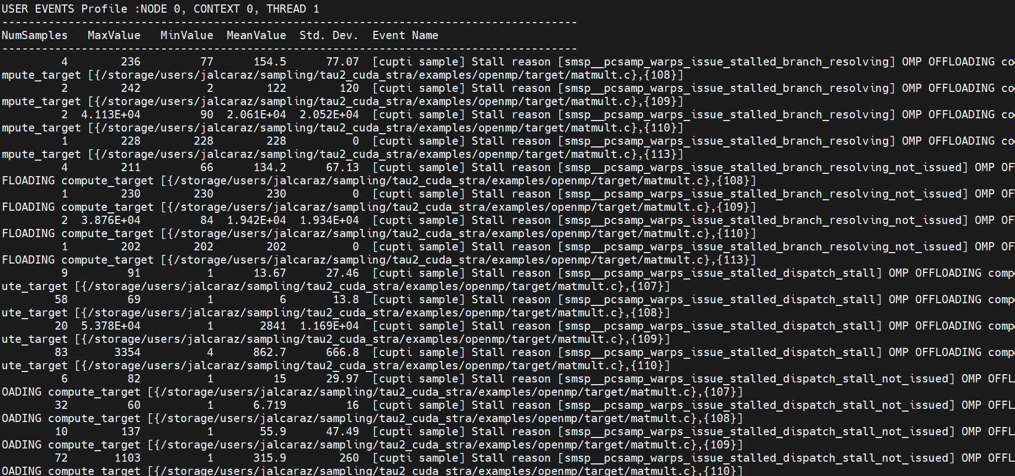
CUDA sampling output
Samples are received as a summary.
Total=NumSamples*MeanValue

Slide 18
Level Zero sampling
Low overhead
Provides stall reason if available
Does not provide timestamps
Available Intel(R) Data Center GPU Max Series and later GPUs
  Needs EUStallSampling event
Can set sampling interval with TAU_L0_SAMPLING_INTERVAL
Interval in microseconds
tau_exec –l0_pc <application>

Slide 19
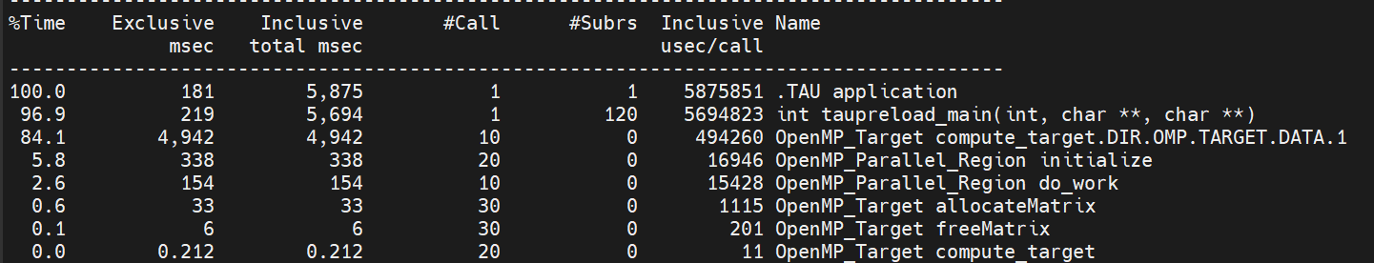
Level Zero sampling
Without sampling nor Level Zero

Slide 20
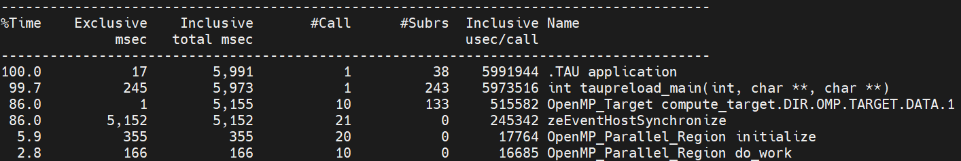
Level Zero sampling
Without sampling nor Level Zero
Without sampling

Slide 21
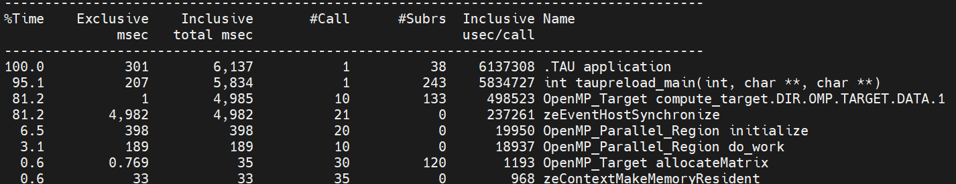
Level Zero sampling
Without sampling
With sampling, overhead around 2%

Slide 22
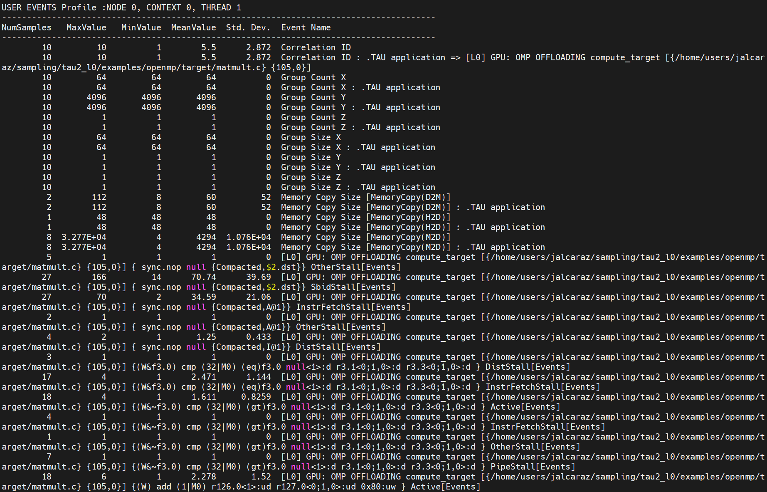
Level Zero sampling output

Slide 23
ROCm sampling
Beta feature. We need to enable env variable ROCPROFILER_PC_SAMPLING_BETA_ENABLED
Adds significant overhead
Rocprofiler-sdk can use two different sampling modes
tau_exec -rocm_pc <application>
Notes:
https://rocm.docs.amd.com/projects/rocprofiler-sdk/en/latest/how-to/using-pc-sampling.html

Slide 24
ROCm sampling modes
Host-trap sampling:
Software-based using a background kernel thread
Samples at intervals and outputs the current instruction
Intervals are defined in nanoseconds
tau_exec -rocm_pc_host <application>
Stochastic sampling:
Hardware-based using specific hardware inside the GPU
Provides stalls if an instruction was not issued
Intervals are defined as cycles using MHz
tau_exec -rocm_pc_stoc <application>
Notes:
https://rocm.docs.amd.com/projects/rocprofiler-sdk/en/latest/how-to/using-pc-sampling.html

Slide 25
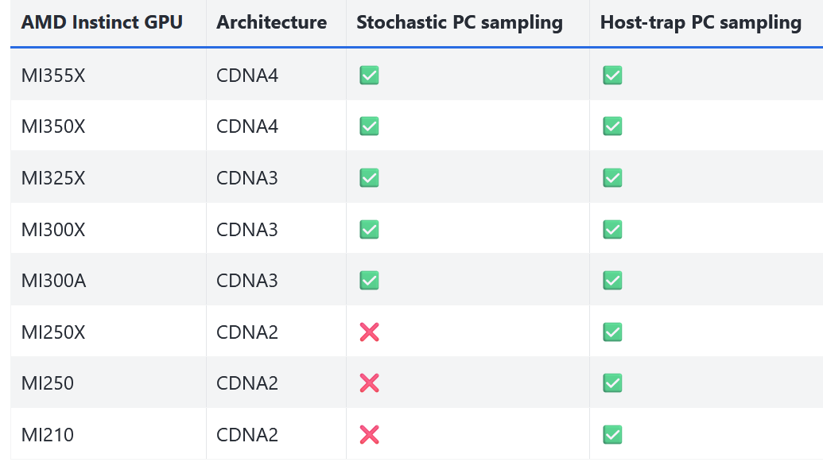
ROCm sampling

Slide 26
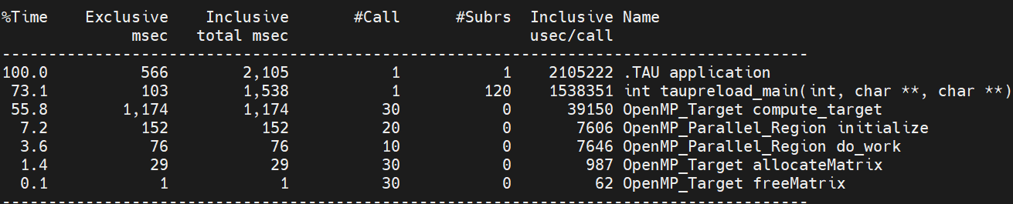
ROCm sampling overhead
Without ROCm profiling

Slide 27
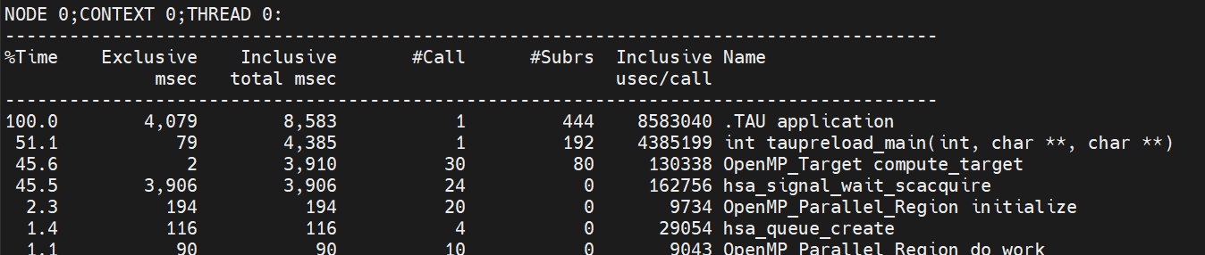
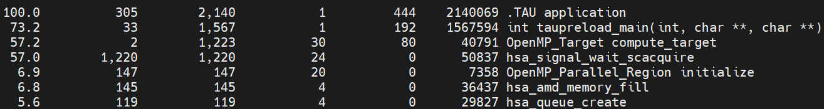
ROCm sampling overhead
Without ROCm profiling
With ROCm profiling

Slide 28
ROCm sampling overhead
With ROCm profiling
ROCm sampling enabled, overhead 300%

Slide 29
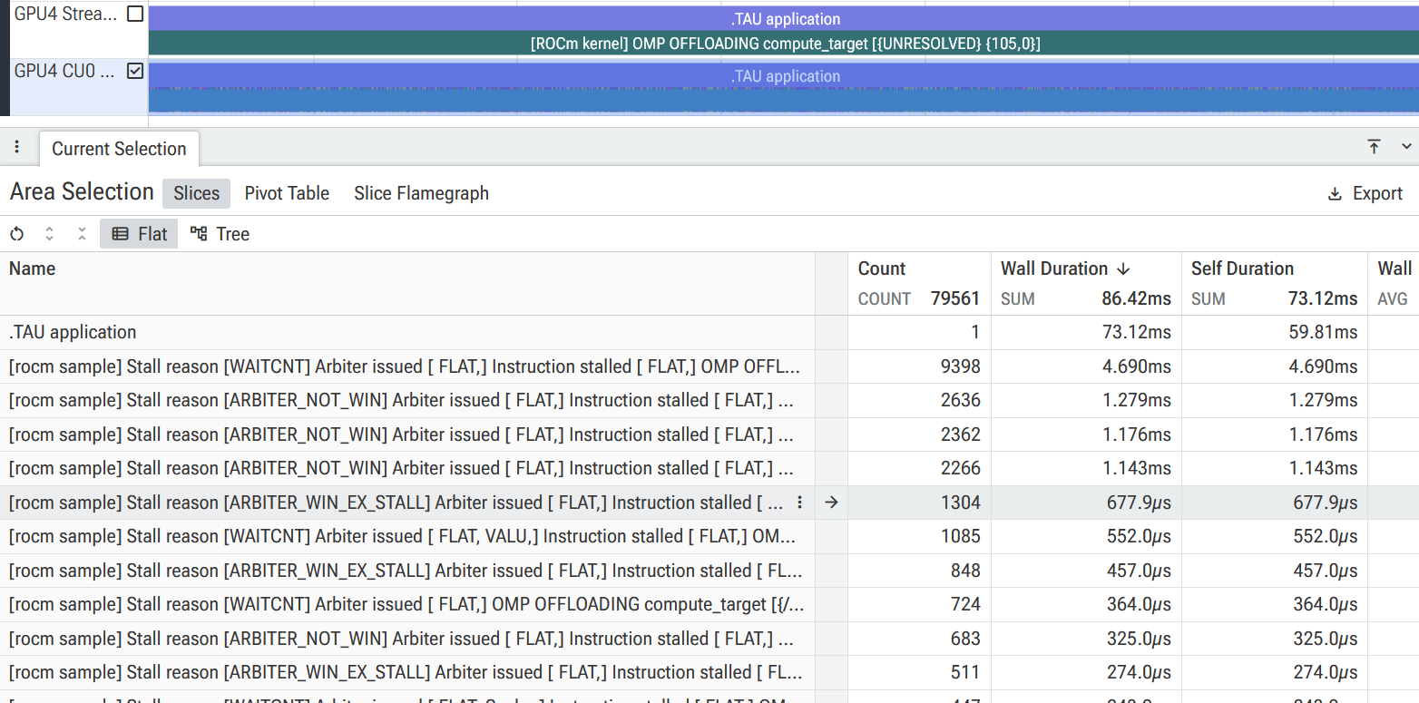
ROCm sampling with tracing

Slide 30
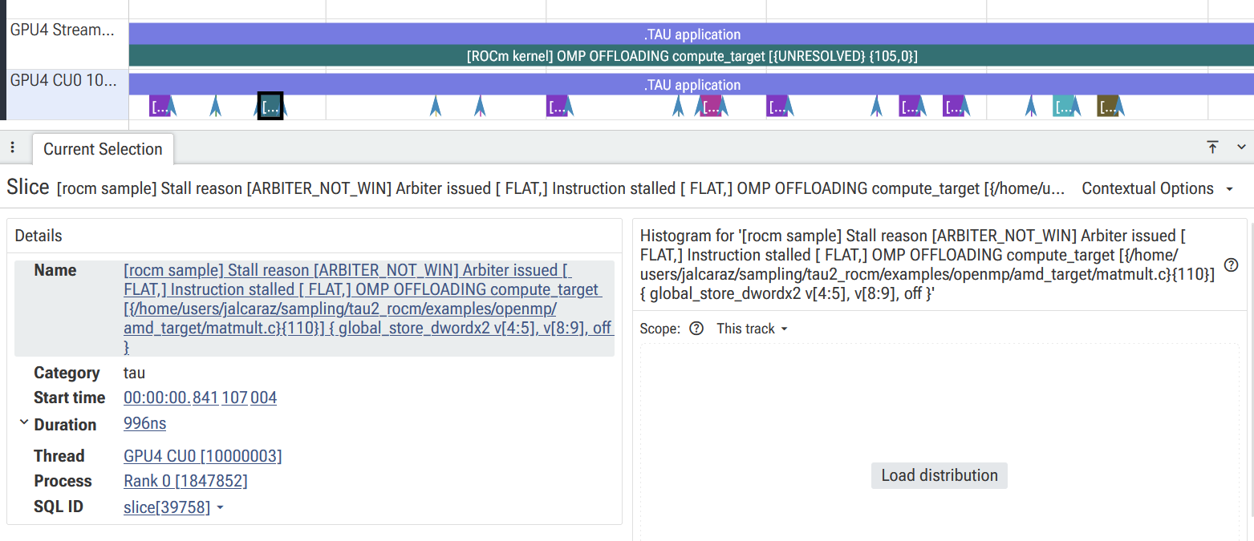
ROCm sampling with tracing

Slide 31
Conclusions
CPU and GPU sampling can be performed using TAU
CPU sampling has low overhead
GPU sampling overhead depends on the application
  Can be low with single streams
  Or very high with multiple streams due to kernel serialization

Slide 32
TAU sampling
CPU event based sampling
  Architecture independent
  No external API dependency
  Stops application at set intervals
  Low overhead
GPU
  API dependent
  Works with CUDA>12, ROCM > 7 and Level Zero
  Can only be used when GPUs support sampling

Slide 33
Future Work
Update to newer Intel API
Update ROCm support and reduce overhead
Modify CUDA implementation:
  Try to print stalled instruction, not only code lines
Improve readability

Slide 34

Download TAU from U. Oregon
http://tau.uoregon.edu
https://e4s.io [TAU in Docker/Singularity containers]
Free download, open source, BSD license

Slide 35




Acknowledgment
This material is based upon work supported by the U.S. Department of Energy, Office of Science, Office of Advanced Scientific Computing Research, Next-Generation Scientific Software Technologies program, under contract numbers DE-AC02-06CH11357, DE-AC05-00OR22725,
DOE SBIR DE-SC0022502, Sandia National Laboratories Contract PO 2542488, and NSF OAC award 2311831.
https://science.osti.gov/ascr
https://pesoproject.org
https://ascr-step.org
https://hpsf.io
https://www.energy.gov/technologytransitions/sbirsttr

Slide 36


